Slide 1
Logbook - Aug

Slide 2
Contents
Fixed point implementation on K64F and KL05Z
Energy consumption
Memory requirement
Running Time
Accuracy testing on MATLAB

Slide 3
Fixed point implementation
Worth to Mention
On K64F, no multiplication is used.
On KL05Z, one multiplication is used in ASO ->does not support CLZ
Mean of the buffer could fade because no float point number is used
-> recalculate the mean every 500 samplings
ASO results are reduced by 2^9 to be contained with a short

Slide 4
Energy Consumption & Running Time
Fixed point ASO |  | K64F(ARM - M4 @120Mhz) | KL05Z(ARM – M0+ @48MHz)
Extra Energy in Processing | Subtract mean | 187.2pJ | 87.45pJ
 | ASO | 14.4pJ | 9.08pJ
 | Thresholding | 182pJ | 242.43pJ
Total Extra Energy |  | 383.6pJ | 338.96pJ
Extra Energy per Sec @ 4000Hz |  | 1.53uJ | 1.36uJ
Total Energy @ 4000Hz |  | 29.46mJ | 3.24uJ
Processing Time | Subtract mean | 0.16us | 0.578us
 | ASO | 0.11us | 0.06us
 | Thresholding | 0.28us | 0.82us
processing time |  | 0.55us | 1.448us
Channels supported @ 4000Hz |  | 454 | 172
The Extra energy reduced for only 13%, because of the long thresholding time.
However, the total energy is reduced by nearly 10^4.
The number of available channels are acceptable.
*Float point ASO and NEO are also compared. NEO consumes 4.328uJ every sec,
while it is reduced for about 1uJ when using ASO to emphasis the spikes.

Slide 5
Memory Requirement
Float point Implementation
Floats & ints 94 -> 94*4bytes
~0.37k
Fixed point Implementation
Shorts 90 90*2bytes
~0.18k
Reduced for about 0.2k, or 51.4%

Slide 6
Performance with Fixed Point Implementation
Parameters*:
C for threshold: 27
Update frequency: every 800 samples
Mean recalculating frequency**: every 1000 samples
* Obtained by a grid searching on independent data.
** Reduce Mean Recalculating Frequency can increase the accuracy but also increase the energy consumption.

Slide 7
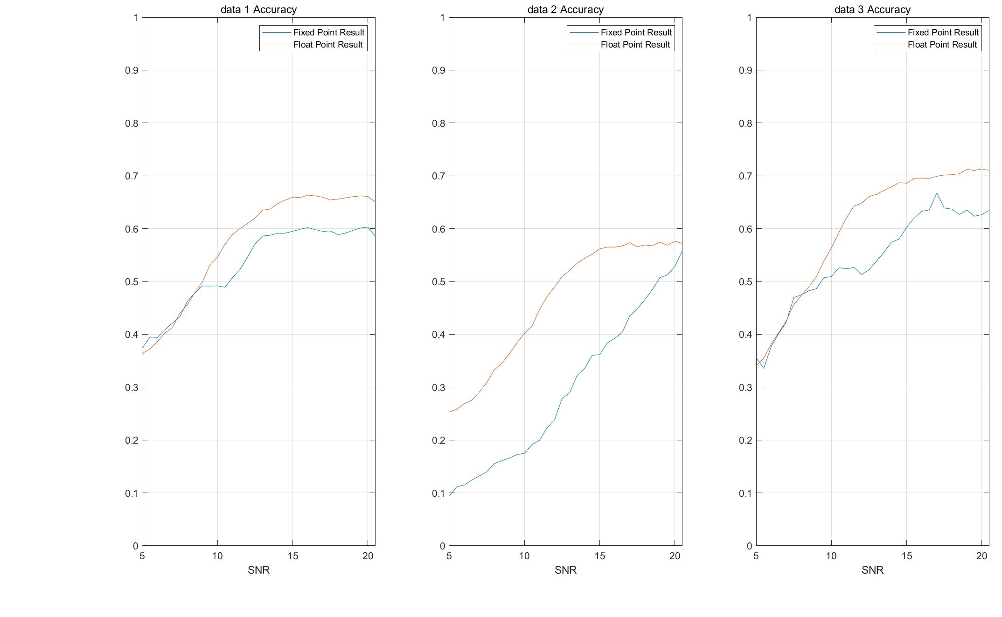
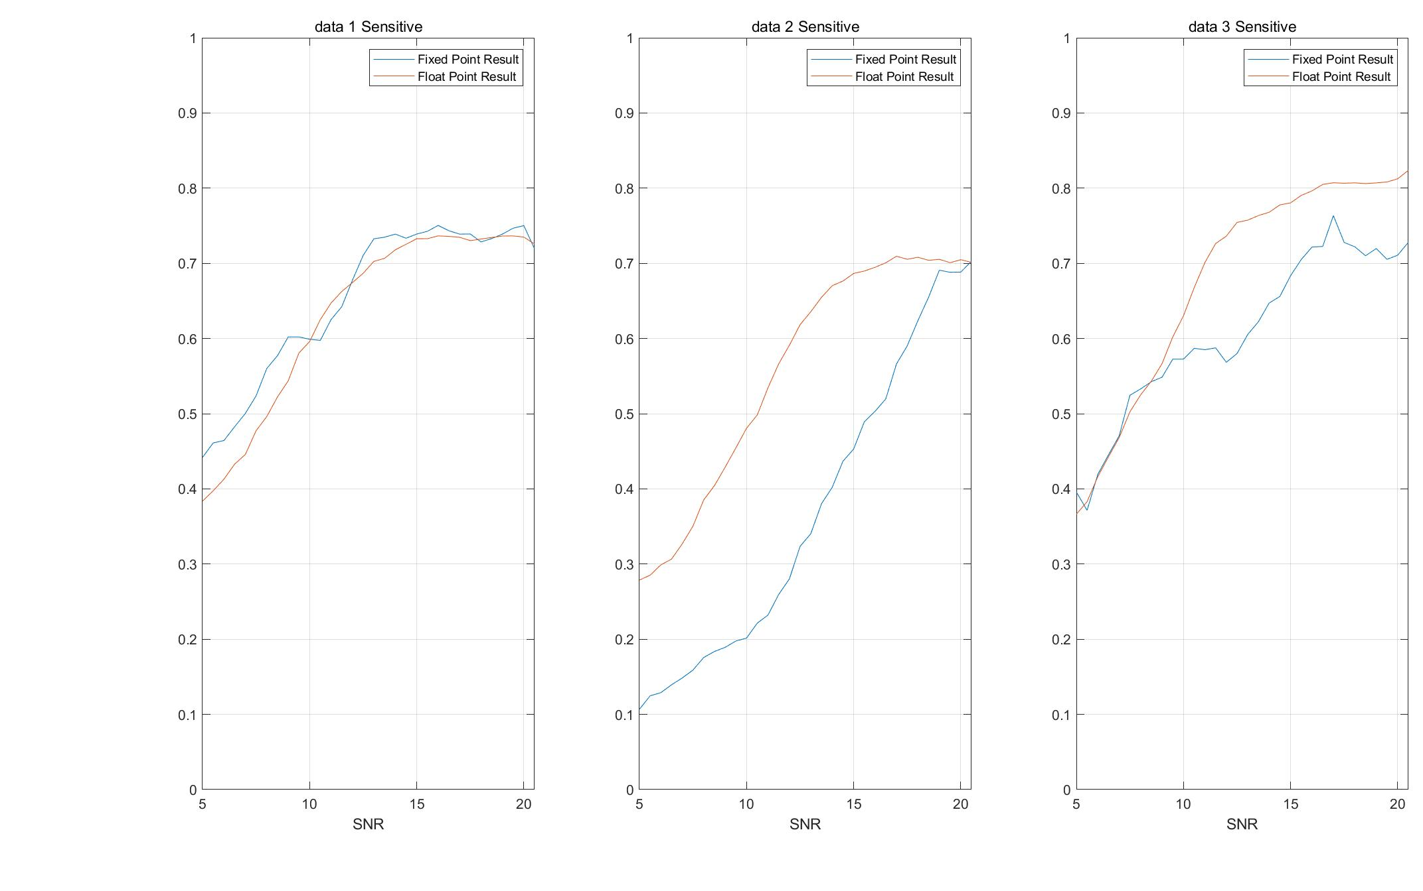
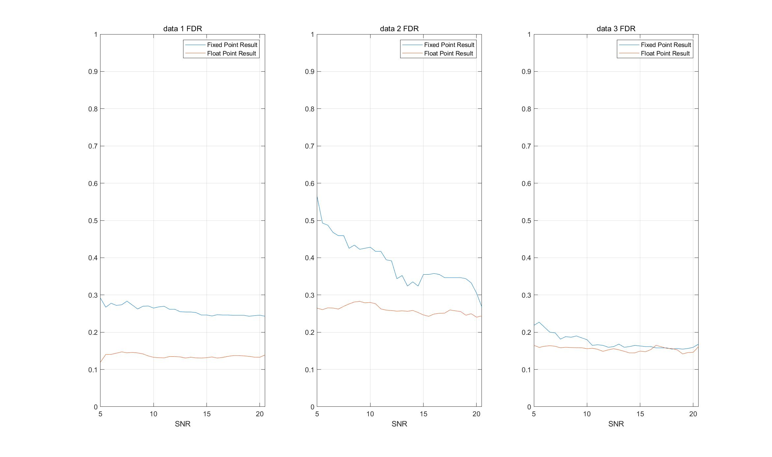
Results on Different Noise Level
The accuracy is reduced by about 5~7%, Sensitive reduced by 1~7%, while FDR is increased by 1~10%.
Performance becomes more data dependent and less robust.
With this scarification, the energy consumption is reduced for about 50% in ARM - M4 and the multiplication unit can also be reduced (not true in M0+).

